Slide 1


AWS SOLUTIONS ARCHITECT ASSOCIATE
Module 8:
Databases and AWS

Slide 2
Module Overview
Database Primer
Amazon Relational Database Service (Amazon RDS)
Amazon Redshift
Amazon DynamoDB

Slide 3

Lesson 01: Database Primer

Slide 4
Database Primer
Relational Databases
Data Warehouses
NoSQL Databases

Slide 5
Lesson 02: Amazon Relational Database Service (Amazon RDS)

Slide 6

Amazon Relational Database Service (Amazon RDS)
Database (DB) Instances
Operational Benefits
Database Engines
  MySQL
  PostgreSQL
  MariaDB
  Oracle
  Microsoft SQL Server
  Amazon Aurora
Amazon RDS

Slide 7
Amazon Relational Database Service (Amazon RDS)
Database Engines
  Licensing
    License Included
    Bring Your Own License (BYOL)
  Amazon Aurora
    Primary Instance
    Amazon Aurora Replica
  Storage Options
    Magnetic
    General Purpose (SSD)
    Provisioned IOPS (SSD)

Slide 8
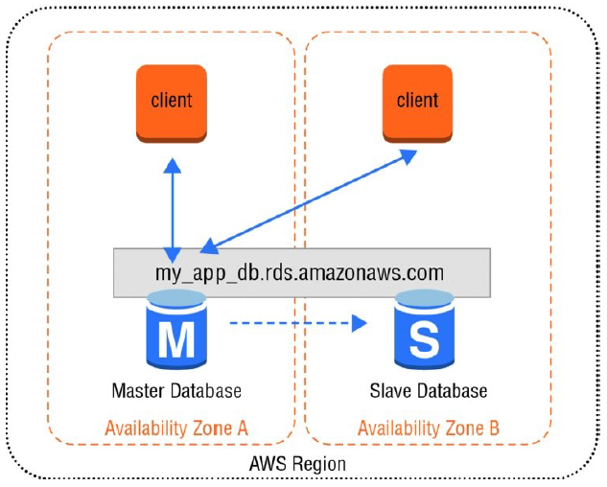
Amazon Relational Database Service (Amazon RDS)
Database Engines
  Backup and Recovery
    Automated Backups
    Manual DB Snapshots
    Recovery
  High Availability with Multi-AZ
  Scaling Up and Out
    Vertical Scalability
    Horizontal Scalability with Partitioning
    Horizontal Scalability with Read Replicas
  Security

Slide 9
Lesson 03: Amazon Redshift

Slide 10

Amazon Redshift
Clusters and Nodes
Table Design
  Data Types
  Compression Encoding
  Distribution Strategy
  Sort Keys
Loading & Querying Data
Snapshots
Security
Amazon Redshift

Slide 11
Lesson 04: Amazon DynamoDB

Slide 12

Amazon DynamoDB
Data Model
Data Types
Primary Key
  Partition Key
  Partition and Sort Key
Provisioned Capacity
Secondary Indexes
  Global Secondary Index
  Local Secondary Index
Amazon DynamoDB

Slide 13
Amazon DynamoDB
Writing and Reading Data
  Writing Items
  Reading Items
  Eventual Consistency
  Batch Operations
  Searching Items
Scaling and Partitioning
Security
Amazon DynamoDB Streams
Amazon DynamoDB

Slide 14
Lab Module 7

Slide 15
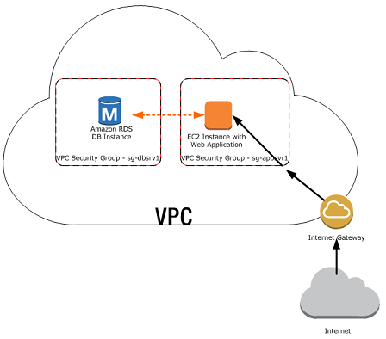
DB Instance

